Slide 1
Jesus came to help us imagine and co-create
a better, more loving world.
Congregation Council Discussion Forum
August 17, 2025

Slide 2
Agenda
Welcome! Thank you for joining us today.
Three-Year Plan (3YP) Updates
A retrospective on the Journey so far and a Look Ahead
Deepening Faith: Preschool Strategy Team Progress
Serving & Transforming Community: Serving Ministry Updates
Responsible Stewardship: Facility & Technology Upgrades
Financial Updates
Q&A, Closing & Thank You

Slide 3
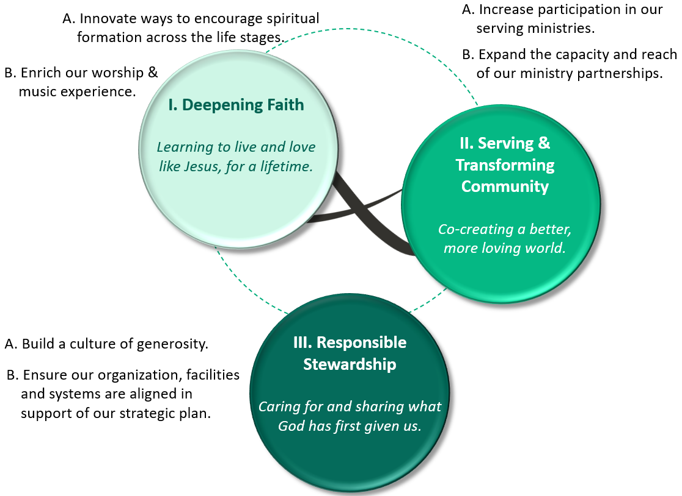

Three-Year Plan (3YP) Updates
3YP
3
Notes:
I agree with Pastor Kai. I was also taken and very encouraged by what is drawing people to our community.
Now, let’s shift from 2022 to 2023 and beyond.
As we look forward, the council, would like to build a multi year plan to commence in 2024. And of course, the participation of both staff and the congregation will be important.

Slide 4
Three-Year Plan (3YP) Timeline
2027 (Year 3)
3YP Sustainability & Looking Ahead:
Mature Ministry Expansion & Continued Progress on Growth Opportunities, Strategize for Phase II Roof Replacement and Mortgage completion.
2025 (Year 1)
The 3YP Launches!
BFOF Funding secures Phase I Roof Replacement & other Prioritized Facilities Projects, Staffing for Ministry Expansion
Our multi-year Journey is building momentum!
2022 – 2023
Congregation, Council, and Staff Feedback Sessions
2026 (Year 2)
3YP Traction Builds:
Complete Remaining Prioritized Facilities Projects & Update 5-Year Facility Plan, Accelerate Targeted Ministry Growth Goals, Identify Longer-Term Transformational Opportunities
2024 (Year 0)
3YP Planning year:
3YP Vision & Goals outlined, Building for Our Future Funding Campaign launched.
Early Wins with Window Replacements and Solar Installation Funding

Slide 5


Ministry Updates
  Deepening Faith: Goals
  Innovate ways to encourage spiritual formation across the life stages
  Enrich our worship & music experience
  Growth Strategy updates for the Incarnation Preschool
  The Incarnation Preschool has been in operation since 1997 as an outreach program to children and families from the surrounding communities.
  What makes us different?
  It is because our foundation is deeply rooted in faith, creating a nurturing community that embraces each child and their unique family. We believe in providing connections within a loving learning environment, where caring staff work side by side with families, building lasting impressions and fostering a sense of belonging. Our approach goes beyond a traditional preschool; we are a community that partners with families, planting seeds for faith development and values while empowering inquisitive minds to soar.
  The newly drafted Preschool Strategy Mission Statement:
  Inspired by faith to nurture inquisitive minds within a caring community

Slide 6

Strategizing for a Successful Future for Our Preschool
An Update on Our Strategic Planning Journey
A Special Thank You to Our Awesome Preschool Planning Task Force:
Kirsten Henry
Bev Ogren
Karen Graden
Sue Bernlohr
Martie Martin
Amy Johnson
Meg Cambronne
Carrie Grafstrom
Presenter: Jim Meinen, Facilitator
6

Slide 7

Our Process and the “Why”
Why is this Work So Important?
Discovery & Research
  The Need for Change:
  The preschool market has changed
  Enrollment has declined over the years
  Adopt to the changing needs of families
Finalizing Our Plan
SWOT Analysis
  Our Strategic Ministry:
  An outreach to new young families
  Brings life and energy five days a week
  Creates a bridge for children to connect with faith and our community
Growth Options
Strategic Options (TOWS)
SWOT: Common strategic planning tool to evaluate current state – strengths, weaknesses, opportunities, threats (i.e. risks).
TOWS: TOWS Analysis is a strategic planning tool that builds directly on the SWOT analysis. While SWOT helps us understand our current situation, TOWS helps us think systematically about what to do about it.
7
Notes:
Our team has followed a very disciplined, data-driven process... But this isn't just about numbers. It's about ensuring the long-term health of what we believe is a cornerstone ministry for our church
Our Strategic Ministry: A thriving preschool is one of Incarnation's most vital ministries. It is our primary outreach to new young families, it brings life and energy into our building five days a week, and it creates a natural bridge for children to connect with our faith community.
The Need for Change: Our research shows the preschool market has changed. Enrollment, which was once at 100% with a waiting list, is now at 54% capacity. To thrive, we must adapt to the needs of today's families.

Slide 8

Our Path Forward: Four Strategic Pillars
  🚀 Pillar 1: Drive Growth
    By expanding our program offerings to meet the needs of today's families.
  🤝 Pillar 2: Strengthen Connections
    By deepening the integration between the preschool, church, and our parent community.
  💰 Pillar 3: Make Strategic Investments
    By investing in our people, facilities, and financial health to support our growth.
  📢 Pillar 4: Build Our Brand
    By implementing a targeted marketing plan to share our story & reach new families.
8
Notes:
Based on all our research and discussion, the team has aligned on a clear direction for the future, built on these four strategic pillars. These pillars will guide all our decisions as we finalize the plan.

Slide 9

What's Next on Our Journey?
We Are Here:
Two volunteer working groups are currently conducting detailed research on three potential growth models for the preschool.
Our Goal:
To have a final, council-approved 3-Year Strategic Plan by year end.
How You Can Help:
Pray: For the planning team, the working groups, and the future of this vital ministry.
Share: Be an ambassador for the preschool. Share your positive stories with friends and neighbors.
Stay Tuned: Look for more updates as we finalize the plan this fall.
9
Notes:
So where are we now? Our teams are hard at work researching the best path forward... We are on track to have a final plan by the end of the year. In the meantime, we ask for your prayers and your support as ambassadors for our wonderful preschool. Thank you."

Slide 10






Service Opportunities
  Serving & Transforming Community: Goals
  Increase participation in our serving ministries
  Expand the capacity and reach of our ministry partnerships
A
Looking for ways to get started? Serving after-worship refreshments is a great option. Sign-up under “Serve in Hospitality” (access through the Serve link at top of the Home Page).
3rd Annual Block Party: Friday, Sept. 5 5-8 PM | Thursday Nov 6: Red Cross Blood Drive at ILC | September - April CYF Ministry Volunteers
Support the event as a volunteer or participant. Either way, bring a friend!
Celebrating our 2-Year Anniversary of Red Cross Blood Drives at ILC!
ILC Kids Small Group Leaders
Sundays 9 AM,
Wednesdays 6 PM
10

Slide 11
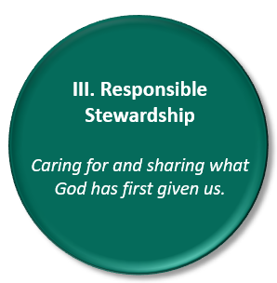


Facilities Updates
  Responsible Stewardship: Goals
  Build a culture of generosity
  Ensure our organization, facilities and systems are aligned in support of our strategic plan
2025: Let’s celebrate our progress!
Phase I Roof Replacement is nearing completion
Solar Installation construction getting underway
HVAC Controller upgraded
HVAC Units hardware procurement under review
Looking Ahead to 2026:
HVAC rooftop units upgrade
Tax Rebate for Solar Installation ($110K)
Sanctuary Updates
Organ Repair
Additional parking lot improvements
11

Slide 12
Facilities Updates
  Responsible Stewardship: Goals
  Build a culture of generosity
  Ensure our organization, facilities and systems are aligned in support of our strategic plan
Building for Our Future Financial Updates
100% Total Needed for all Projects/Ministry Expansion: $2,830,000
84% Total Funds Received (as of mid-July): $2,389,709
Still Needed for 2025-2026 Projects: $ 440,291
BFOF project spend projections by year:
Spent in 2024: $ 187,000 Windows, Solar Supplies, Ministry Partners
Projected Spend for 2025: $2,223,000 Roof & HVAC Phase I, Solar, Ministry Partners/Staffing
Projected Spend for 2026: $ 420,000 Parking, Sanctuary/Organ Repair, Ministry Partners/Staffing
12

Slide 13
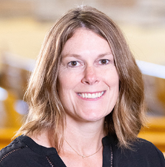
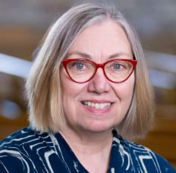
Technology Updates
  Responsible Stewardship: Goals
  Build a culture of generosity
  Ensure our organization, facilities and systems are aligned in support of our strategic plan
Exciting Technology Updates are underway!
      Heather Hoecke
      Director of Operations
      Marina Nyberg
      Director of Communications
  ILC Payroll transitioned to Gusto electronic payroll system
  Optimizing ACH/e-Payments to reduce manual paper-based transactions
  Exploring options for comprehensive and intercompatible financial and donation management systems
  Curates weekly content for Digital Displays
  Synthesizing social media channels with focus on diverse and engaging content
  Partnering with new web developer (Worship Times) to replace current ILC website. Goals for new site include:
    More user-friendly
    Easier & more cost effective to update
13

Slide 14
Financial Updates
Giving typically experiences seasonal dips in the summer months. We appreciate the generous support for both the Building for Our Future and Operating Budgets.
Flex-Able and Internal Financial reviews will be completed this year.
 | June 2025 Reporting | 2025 Actuals Year-to-Date | 2025 Budget Year-to-Date | Variance | Commentary
 | Total Revenues | 1,237,368 | 1,310,908 | (73,540) | Giving ($58.3K); Mortgage ($11.9K)
 | Expenses:
 | Compensation & Benefits | 832,025 | 798,546 | (33,479) | April payroll cadence change (semi-monthly to bi-weekly)
 | Ministry Partners | 67,617 | 68,700 | 1,083 | ILC Preschool funding (timing)
 | Ministry Expenses | 98,790 | 94,499 | (4,291) | Audio/Visual equipment updates
 | Admin (Insurance, IT, Supplies) | 160,910 | 165,337 | 4,427 | Various
 | Facility (Utilities, Grass/Snow) | 65,382 | 83,640 | 18,258 | HVAC/Building Maintenance (timing, invoices anticipated in July)
 | Mortgage/Deferred Maint. | 149,050 | 149,050 | 0
 | Total Operating Expenses | 1,373,773 | 1,359,771 | (14,002)
 | NET TOTAL | (136,405) | (48,863) | (59,538) | Thank you for your continued support of BFOF and our Operating Budget!
14

Slide 15
Q&A
Thanks for coming. Next time, bring a friend.
Next Congregation Update:
Sunday, November 2, 2025
10:15 to 11:15 AM

