Slide 1
Presentation of Nominees for the Congregation Council,
Synod Assembly, & the Endowment Fund Committee
Incarnation Lutheran Church
Congregation Annual Meeting
November 16, 2025

Slide 2
Thank You to the 2025 Nominating Committee
Ted Trahan, Chair Vice President Congregation Council
Kevin Roloff 2ND year Council member/Council Secretary
Mike Vant 2ND year Council member/Council Treasurer
Kai Nilsen Senior Pastor
Diane Betterley Hands and Hearts
Carrie Grafstrom Worship Arts
Rick Gravley Facilities Committee
Rosalie Grosch Global Health Ministries Action Group
Bill Reichwald Cemetery Committee
Nancy Stutzman Small Group Ministry Team
Mike Styba Human Resources Committee
Mark Tollander Endowment Committee
Claudia Wiebold Ralph Reeder Action Group

Slide 3
Process for Nominations
The Nominations Committee chair invites the leads of the ministry teams, Action Groups and committees to participate on the committee.
As the process gets underway, Council shares updates in Lifetimes to invite congregation members to express interest in serving on these roles.
The nominations committee members submit names for consideration for each of the elected roles – Council, Synod Assembly and Endowment Fund Committee.
Identified candidates are contacted to confirm their interest and willingness to serve. Details are shared on the roles and the approval process. The candidates provide detail on their background that will be supplied to the congregation.
We host the Annual meeting to seek the Congregation’s approval for the nominated candidates and thank everyone involved with the process.

Slide 4
Process for Nominee Approval
Share brief introductions for the nominees.
Call for a motion to accept the nominees.
Confirm a “second” for the motion.
Open the floor for discussion and questions.
Call for a vote.

Slide 5
Congregation Council (Three-Year Term)
Outgoing Council Members:
Jim Meinen and Amy Johnson
Returning Council Members:
Tracy Strantz
Ted Trahan
Mike Vant
Kevin Roloff
Steve McCormack
Katie Solfest
Sheri Hansen
Pastor Kai Nilsen
Notes:
5

Slide 6
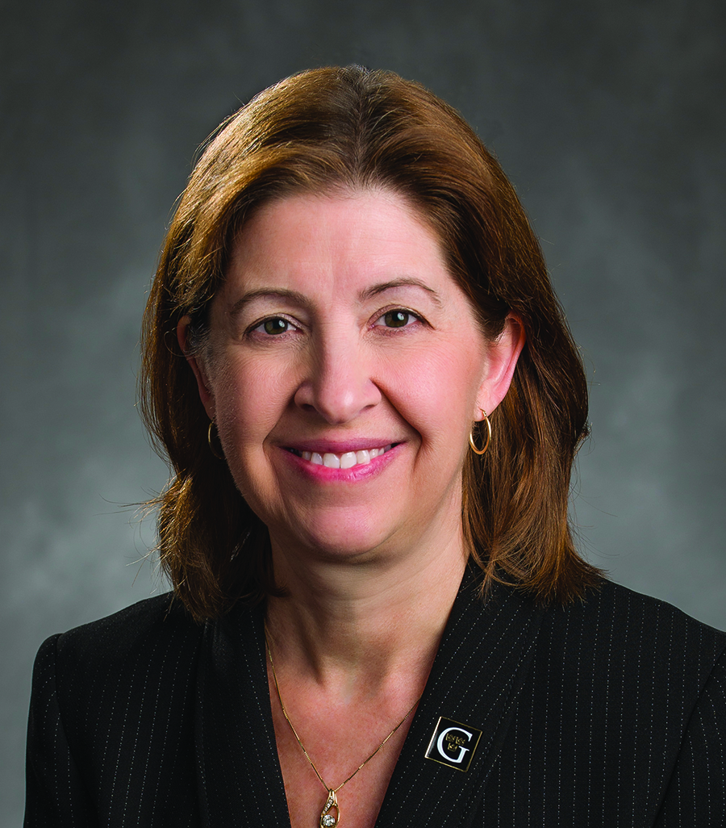
Nominee for Congregation Council
Rebecca Bergman,
Nominee for Church Council
Rebecca recently retired in August 2025 after serving 11 years as the 17th President of Gustavus Adolphus College, one of the 28 Colleges and Universities of the ELCA, located in St. Peter, Minnesota. Prior to assuming the role as the first woman president at Gustavus, Rebecca served on the Gustavus Board of Trustees from 2007-2014. During her tenure at Gustavus, Rebecca has been recognized for generating over $400 million in documented philanthropic support for the College, driving academic innovation, and leading three major building projects on campus.
Rebecca’s non-traditional path to college leadership included 26 years at Medtronic, Inc., where she served in senior executive positions in research and development and was closely involved in long-term strategic planning. During her tenure at Medtronic, Rebecca was elected as a Fellow of the American Institute for Medical and Biological Engineering and was elected to the National Academy of Engineering.
Rebecca holds a B.S. degree in Chemical Engineering from Princeton University, completed graduate studies at the University of Minnesota, and has received honorary doctorate degrees from Gustavus Adolphus College, Drexel University, and St. Catherine University.
Rebecca and her husband, Tom, have been residents of North Oaks since 1990 and members of Incarnation since 1996. They are proud parents of four grown children and have been blessed with four young grandchildren. Rebecca previously served on the Incarnation Council in the mid-2000’s, including serving as President of the Congregation during that time.
6

Slide 7
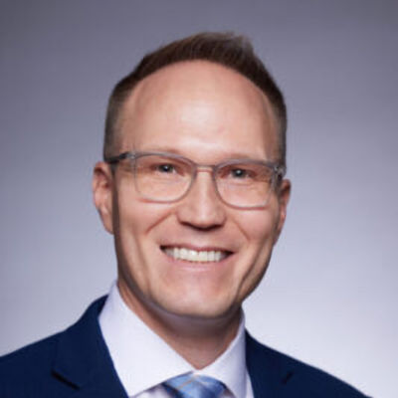
Nominee for Congregation Council
Matt Cambronne,
Nominee for Church Council
Matt was born and raised in Dayton, MN (near Maple Grove). He graduated from Iowa State University with a B.S. in Materials Science and Engineering and graduated from Augsburg College with an M.B.A
Matt logged 22 years in medical device research and development, including stints at Boston Scientific, Cardiovascular Systems, and Endogenex (present). He brings skills in Team leadership and Business process experience, including Strategic planning, Annual operating planning, and Organization and talent planning.
Matt says his family has been blessed to attend ILC for 11yrs. Matt is married to Meg, and they have two daughters Charlotte (14) and Sadie (9). They have served and participated in roles such as ILC brass, Communion servers, Sunday school teacher, Confirmation, and Feed My Starving Children. Both daughters attended ILC pre-school
Matt’s interest include all things outdoors, notably:
Remote wilderness camping (summer & winter), Running, Pickleball, Fishing, Boating, Snowmobiling, Woodworking and Travel.
7

Slide 8
Synod Assembly Representatives (Three-Year Term)
Current Synod Assembly Representatives:
Claudia and Don Wiebold
Vernita & Dale Kennen
Rosalie Grosch
Deacon Jerry Dufeck - Advisor
Notes:
8

Slide 9
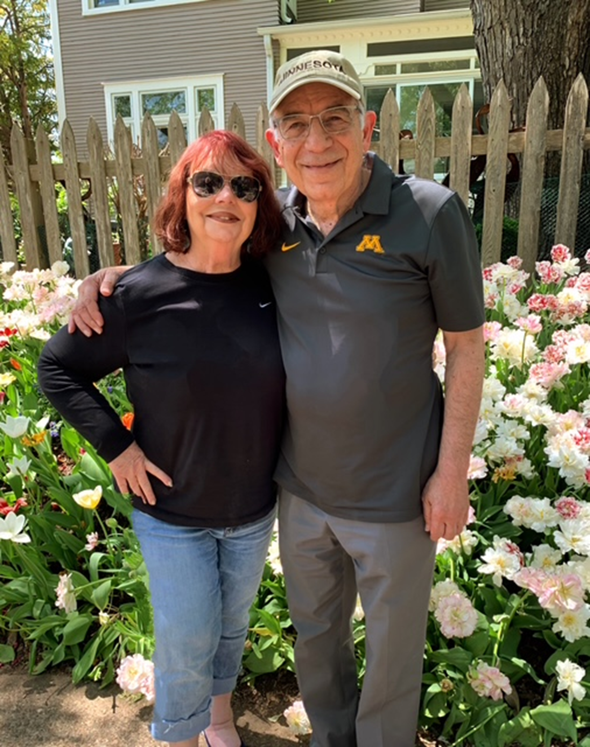
Nominees for Synod Assembly Representative
Patti and Bryce Williams,
Nominees for Synod Representatives
Bryce is a retired CPA. He volunteered with Steve Ogren on an earlier ILC Financial Review, and they are now working on the 2024 ILC Financial Review. Bryce has volunteered with Feed My Starving Children, Soup Suppers, and for Wednesday pizza nights. He is a member of the Incarnation’s men's history book club.
Patti Williams was born, raised, and married in the suburbs of Pittsburgh, PA. , where her and Bryce’s son & daughter were also born. They moved from Florida to MN in November 2021 to be near their daughter, son-in-law, and 3 grandkids, who live in Shoreview. Patti and Bryce joined ILC in 2023 after attending for almost a year.
Patti has been an active school, community, and church volunteer for almost 50 years.
Some of her activities include teaching a Citizenship Prep class and English as a Secondary Language to adult students. She also served on the council at a previous church.
Currently, Patti is involved at Incarnation with All Hands On Hope, serving at Soup Suppers and Wednesday Pizza Nights, and serving as usher and communion server.
9

Slide 10
Endowment Fund Committee (Three-Year Term)
Outgoing Committee Members:
Fred Lawless
Bill Reichwald
Liz Thompson
Returning Committee Members:
Mark Tollander, Chair
Al Montgomery
Matt Rowles, Jr.
Pastor Kai Nilsen
Notes:
10

Slide 11
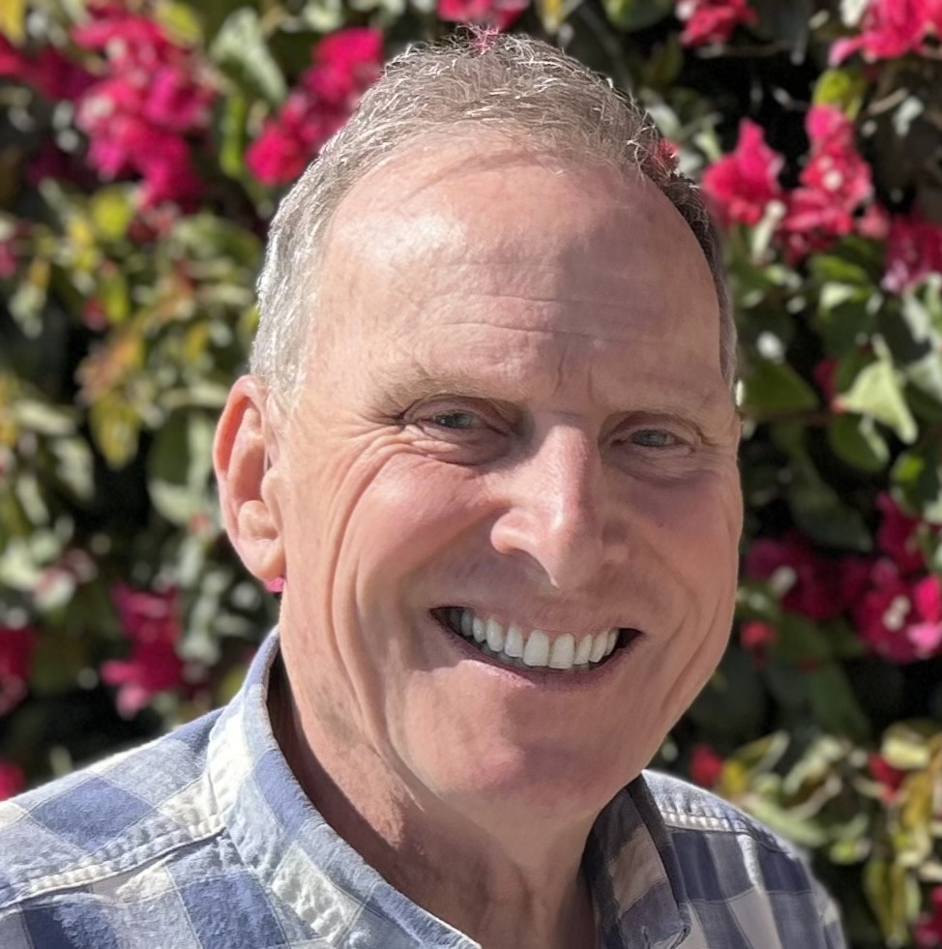
Nominee for Endowment Fund Committee
Dan Kvinge,
Nominee for the Endowment Fund Committee
Dan and his wife Kathy have been attending ILC for many years and have two grown kids and two grandchildren.
Dan retired from Graco after 32 years in design engineering and enjoys repair and maintenance projects at home and around the church.
His favorite summer activity is cloud soaring in his 50' fiberglass glider.
He feels community outreach is an important part of our church ministry and looks forward to helping on the Endowment Committee.

Slide 12
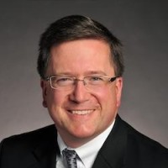
Nominee for Endowment Fund Committee
Craig Ratz,
Nominee for the Endowment Fund Committee
The Ratz family includes Craig and Kari and their three children: Alex, Julia, and Andrew who were all confirmed through the Incarnation program.
I have been blessed over my working career with a variety of experiences, including:
  Manager of an immunology research lab at the U of MN.
  Business Risk Analyst for Norwest Mortgage.
  Trust Officer/Financial Planner with Wells Fargo and BMO.
  Independent Financial Planner/Educator since Fall 2020.
During the financial crisis of 2007 to 2009, I was involved with strategic planning within many large and small Foundations and Endowments (local and national) – weathering the storm.
My involvement within Incarnation has centered around small groups and Feed My Starving Children.
You can often find me out and about in our beautiful community with Kari and our grown children, in the garden, walking our golden retriever, or anything to do with wood – walking in the woods, caring for trees, securing the overall health of our woodlands, and cutting wood by hand saw. Anything to dirty my hands!
12

Slide 13
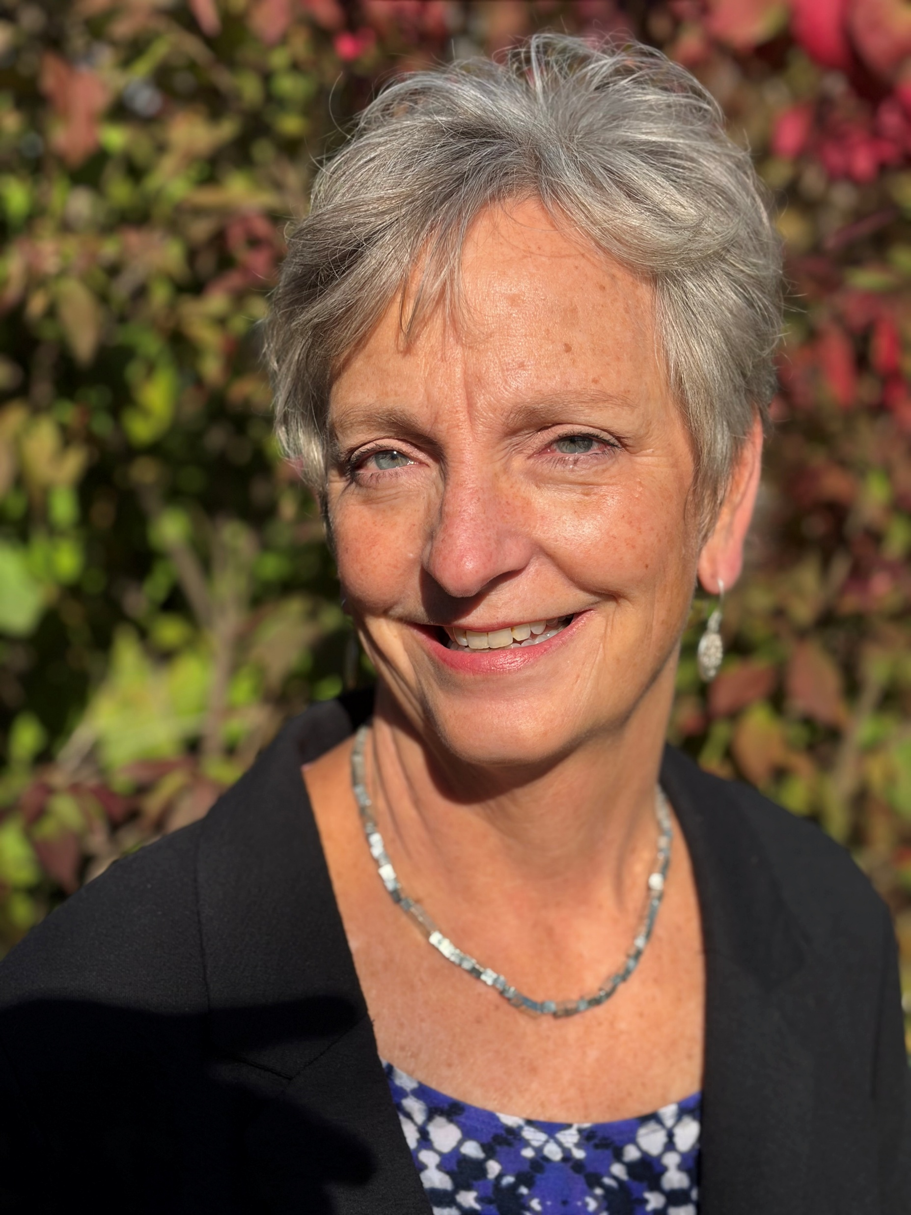
Nominee for Endowment Fund Committee
Donna Rauch,
Nominee for the Endowment Fund Committee
Donna has been an active member at Incarnation since 1993.
Participating in Senior Choir, various small groups, and the preschool helped their family to find community and life-long friendships within the large congregation. Donna’s other involvement over the years has been bell choir, wedding coordinator, Logos study leader and preschool music teacher.
Prior to retirement, Donna worked for LegalCORPS, a nonprofit organization providing non-litigation and intellectual property protection legal aid to entrepreneurs, business owners, inventors, and nonprofits with limited resources and/or access to the legal system. Through her work she experienced first-hand how providing a little assistance can have a positive impact in someone’s life and potentially affect families and communities.
Her hobbies include baking, walking, hiking, biking, pickleball, and travel.
13

Slide 14
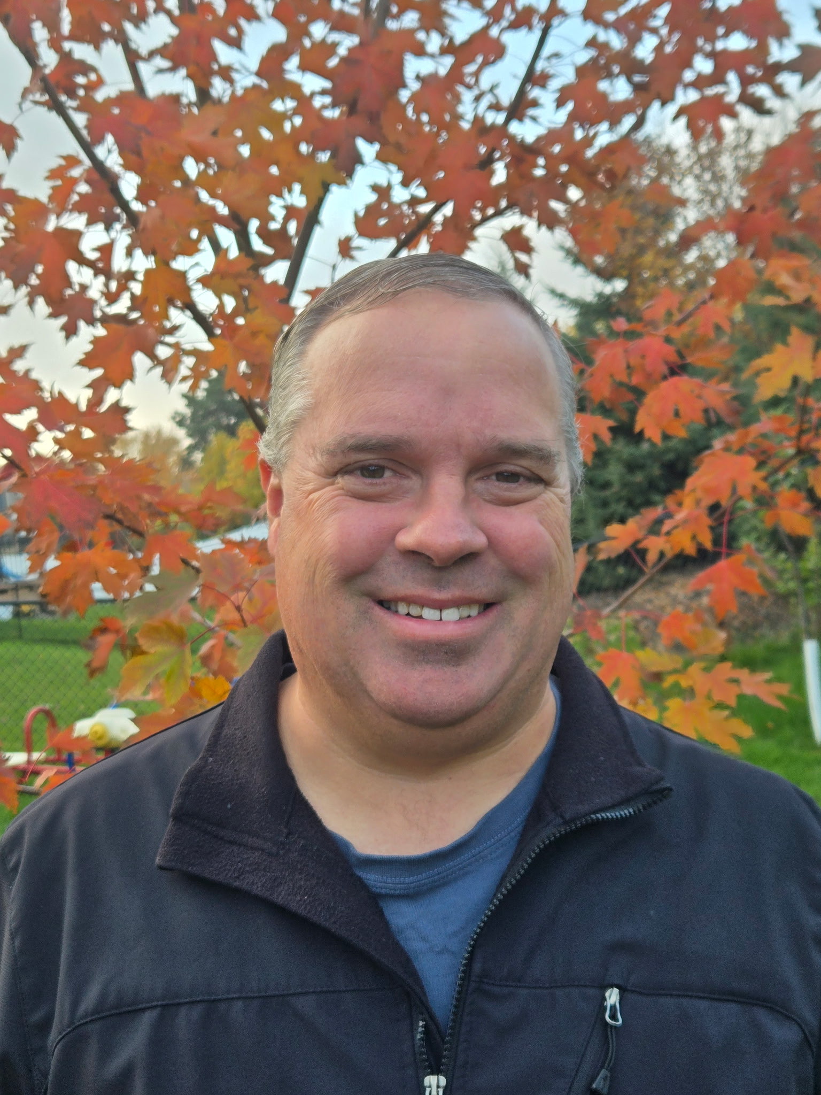
Biographies for Nominees for Elected Roles
Dan Sailsbury,
Nominee for the Endowment Fund Committee
Dan was born and raised in Ames, Iowa. He attended both the University of Iowa and Iowa State University, earning degrees in Science Education and Geology. His loyalty lies with the Iowa State Cyclones.
After college Dan felt fortunate to work as a geologist in some of the most beautiful areas in our country including the Bighorn mountains in Wyoming, the arctic tundra of Alaska, the coastal waters of Maryland, and Chesapeake Bay.
After a career change to the medical field, Dan landed in the Twin Cities where he has resided for the past 22 years and works in healthcare management.
Dan and his wife Megan live in Lino Lakes. They have been married for 11 years and have three children: Calvin (9), Max (7), and Jonah (7).
Dan is an active volunteer in a few organizations. He is a ski patroller for the National Ski Patrol at Afton Alps. He also volunteers for the Cub Scouts. He and his family enjoy the outdoors, and spending time with extended family in Ely and in Iowa.
Dan and Megan have been members of Incarnation for approximately 10 years and feel fortunate to have had the opportunity to be a part of small groups. Their children attended preschool at Incarnation. Dan says being involved at Incarnation has been very rewarding, as he has seen how much the church provides opportunities to its members and people in the community.
14

Slide 15
Nominees for Elected Roles in 2026
Congregation Council (3-year term)
  Rebecca Bergman
  Matt Cambronne
Synod Assembly Representatives (3-year term)
  Patti and Bryce Williams
Endowment Committee (3-year term)
  Dan Kvinge
  Craig Ratz
  Donna Rauch
  Dan Sailsbury

Slide 16
Thank you for participating today.

